Slide 1
Access to Financial Services in Haiti
A Machine Learning Approach

Slide 2
Agenda
01
02
03
04
Introduction
Goal of the Project
Problem
Goals
Methodology
EDA
Describing the process of our project
Providing insights about the data
Recommandations
05
Model
06
Comparisons of the models

Slide 3
01
Introduction
This situation has happened to me multiple times. I had no cash on me and wanted to buy something on the streets from a local merchant. Asked him for his mobile wallet, he said he doesn’t have a mobile money account to receive the money, he can’t sell me.
I wondered why it was so difficult to implement these new payment methods in Haiti.
In Haiti, it is clear that the majority of the population is financially excluded. Do the reliable and responsible providers in Haiti (BRH, Commercial banks, cell phone operators) have difficulty targeting the people in Haiti?

Slide 4
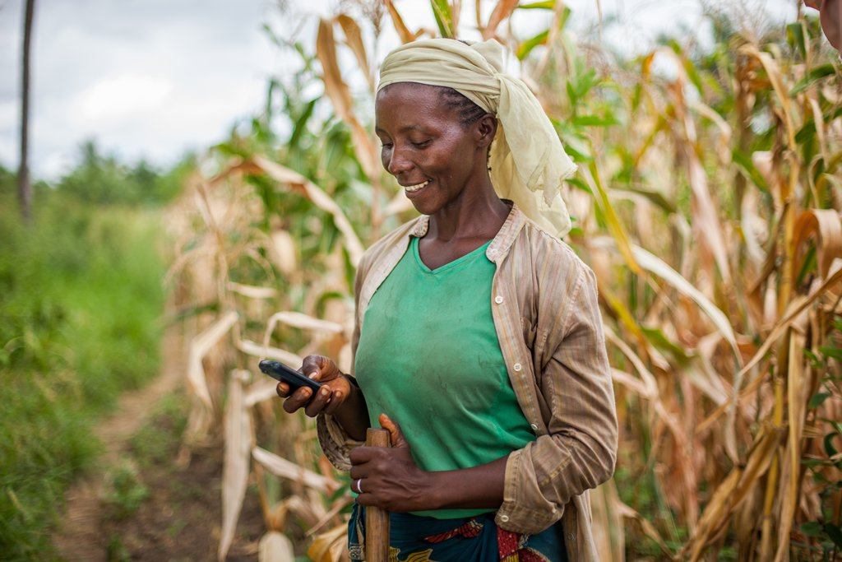
Financial inclusion is the ability for individuals and businesses to access a range of useful and affordable financial products and services (transactions, payments, savings, credit and insurance) from reliable and accountable providers.

Slide 5
Goal of the Project
The objective of this project is to determine if machine learning algorithms can help classify individuals in Haiti on 4 classes :
Banked
Financially Excluded
Using formal financial services (Non-banked )
Using Non-Formal financial services

Slide 6
Target Audience
The target audience of this project is the Central Bank, the commercial banks , MNO’s ,IMF’S and other NGO’s in Haiti.
Financial Services providers can use the model’s prediction for data-driven decisions :
On Strategies like boosting and promoting to better target their audience like implementing social programs for financial inclusion
Developing better financial products for their potentials clients based on demographics and socio-economics drivers .

Slide 7

Data Source
The data we use is from a survey on 4269 people in Haiti about made by Finmark trust in collaboration with Group Croissance and USAID.

Slide 8
Methodology
Collect
Cleaning And Analysis
Modeling
Recommandations
Collecting Data from Finmark Trust
Cleaning Data and EDA using Python Pandas and Numpy
Building a Machine Learning Classification Model with Python
Providing Recommandations to different actors in the financial sectors

Slide 9
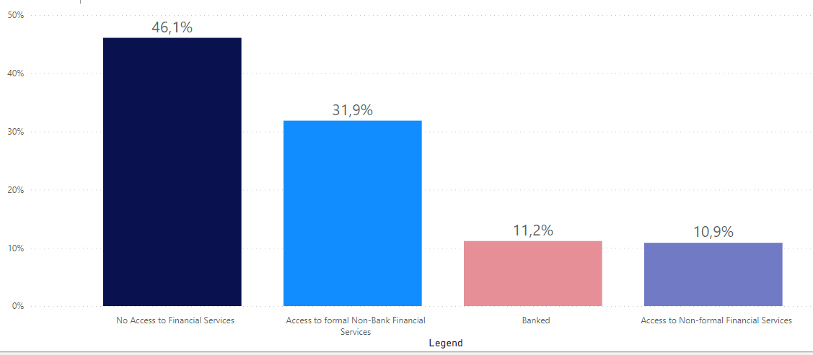
Access to Financial Services.

Slide 10
Keys Numbers
46.1%
Financially Excluded.
65.4%
76.9%
3.96%
Had No schooling
Are Jobless
Had Access to Credits

Slide 11
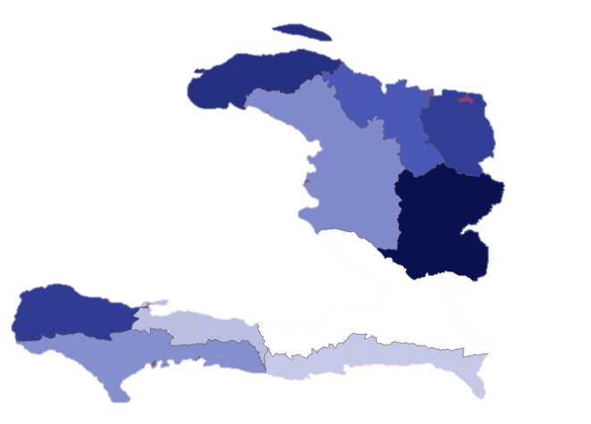
Financially Excluded
Nord-Ouest
2nd state with the most people excluded
Centre
State with the most people excluded
Grand’Anse
3rd state with the most people excluded

Slide 12
Supervised Machine Learning

Slide 13
Model Selection
The appropriateness of different models based on the task at hand, multi-class classification, We will take into account other parameters such as size, shape and other characteristics of the data, training speed.
The Classifier models we will try are :
Support Vector Machine
Random Forest Classifier

Slide 14
Model Selection
We select suitable metrics that are appropriate for multi-class classification problems and have been used for similar tasks.
The metrics will be :
Accuracy score
Recall score

Slide 15
Features Selection
The features that will help us build the model is information's about
Which State they live ?
Socio-Economics Drivers
Documents deliver by the state (ID, passport, Birth cert)
Which communications device, they use or own ?
What they do with their money ?

Slide 16
Model 1
Support Vector Machine
Accuracy
Recalll
Financially Excluded : 92,7%
Banked : 73,4 %
Formal Non-banked services : 83,8 %
Non- formal financial Services : 71,2%
84,20 %
Percent of individual identified in a class that are actually part of the class
Percent of individual in a class that the machine identified in that class

Slide 17
Model 2
Random Forest Classifier
Accuracy
Recalll
Financially Excluded : 92,7%
Banked : 69.2 %
Formal Non-banked services : 85,8 %
Non- formal financial Services : 66,2%
85,54 %
Percent of individual identified in a class that are actually part of the class
Percent of individual in a class that the machine identified in that class

Slide 18
Comparison of the two Models
Support vector Machine vs Random Forrest Classifier
Random Forest Classifier display the highest average score across the 5 folds but SVM has lowest variation in performance .
For imbalanced datasets such as ours, overall accuracy score is not always an appropriate measure. If an overwhelming number of examples are from one class even poor models can achieve high accuracy scores.
We will also rely on recall scores.
So, The SVM perform better considering these metrics.

Slide 19
Conclusion
The purpose of this project was to develop a model to predict the level of financial inclusion among a sample of survey respondents based on socio-economic, demographic drivers.
We chose 2 models that was stable and displayed a high accuracy with the features used to train the model.
To improve the model, we will need updated Data included features about distance to bank agency or mobile agent.

Slide 20
Recommandations to the Private Sector
Accept new payment methods at their point of sale such as mobile money, online payment : Popularizing these new payment methods and explaining how they work would be beneficial to attract more people

Slide 21
Recommandations to the Financial services providers
Facilitate the process of implementing points of service in areas where there are the most people not included.
Allowing more Credit for education and entrepreneurship destinated to the least included individuals.

Slide 22
Recommandations to the STATE
Allow more possibilities for connection between Fintechs (Paypal,Alipay) and commercial banks in Haiti. Individuals could easily make worldwide transactions.

Slide 23
References and appendices
View the full project here : github.com/VIP509/Finance-Inclusion-1
Digital Access : The future of financial inclusion in Africa
Machine Learning — Multiclass Classification with Imbalanced Dataset
Finscope Enquête Consommateur Les Tendances

Slide 24
Thanks
Do you have any questions?
Email : valcinpierry13l@gmail.com
Telephone : +509 3436 6993

